Slide 1


Violence Detection in Surveillance Video using Multiple Models
Session: 2024-2025
Presented by:
Piyush Motwani - (EN21IT301076)
Raghav Mehrotra – (EN21EL301070)
Raj Narayan Singh Chouhan- (EN21IT301083)
Under guidance:
Prof. Jyoti Kukade

Slide 2

Violence Detection in Surveillance Video using Multiple Models

Slide 3
Contents:
Abstract
Problem Statement
Solution
Requirements(Software + Hardware)
Technologies
UML Diagrams
Result
Conclusion
Application
Related Research Work

Slide 4
Abstract:
Our system utilizes deep learning to detect violent events in real-time across various domains, such as surveillance, social media monitoring, and crowd management. By leveraging advanced neural network architectures, it ensures high accuracy in identifying violent activities.
AI models, including CNNs and RNNs, analyze complex spatial-temporal patterns to distinguish violent incidents from normal activities. Transfer learning and data augmentation techniques enhance model performance while addressing class imbalance and contextual dependencies.
The system provides instant and efficient violence detection with real-time alert mechanisms. Evaluation metrics such as accuracy, precision, recall, and F1-score ensure reliability. Future advancements focus on improving contextual awareness and reducing false positives.

Slide 5
Problem Statement:
With the increasing reliance on video surveillance and digital monitoring, the ability to detect violent activities accurately and efficiently has become a major concern in public safety, law enforcement, and online content moderation. Traditional violence detection methods depend on manual monitoring or predefined rule-based algorithms, which are not only labor-intensive but also prone to errors, making them ineffective for large-scale or real-time applications.
Detecting violence is particularly challenging due to the diverse nature of violent actions, the presence of complex contextual cues, variations in camera angles, lighting conditions, and the imbalanced nature of datasets—where violent instances are relatively rare compared to non-violent ones. Additionally, distinguishing actual violent events from aggressive but non-violent behavior (e.g., sports or animated discussions) adds to the difficulty.

Slide 6
Solution:
A Deep Learning-Powered Violence Detection System that leverages AI-driven video analysis to identify violent activities in real-time. Using CNNs, RNNs, and hybrid architectures, the system detects violent behavior with high accuracy, overcoming challenges related to contextual understanding and class imbalance. Transfer learning and data augmentation enhance detection capabilities, while real-time alert mechanisms ensure immediate intervention, making public spaces safer and monitoring systems more efficient.

Slide 7
Technologies:
Computer Vision & Image Processing :
Used OpenCV to process video frames, extract key features, and enhance image quality for better analysis.
Deep Learning & AI Frameworks :
Integrated Convolutional Neural Networks (CNNs) for feature extraction from video frames.
Implemented Recurrent Neural Networks (LSTM, GRU) to model temporal dependencies in video sequences.
Machine Learning & Model Optimization :
Utilized TensorFlow and Keras to train and fine-tune models for optimal accuracy.
Applied data augmentation techniques to improve generalization and robustness against variations in video data.
Real-Time Processing & Deployment :
Integrated Flask to serve the trained model as a web API for real-time video classification.

Slide 8
Functional Requirements:
Real-Time Detection:
The system must continuously capture and analyze live video feeds.
Frames should be processed quickly to ensure minimal latency and instant detection of violent activities.
Accurate Classification:
Deep learning models (CNNs, LSTM, GRU) should be used to classify violent and non-violent events.
The model should achieve high precision and recall, reducing false positives and negatives.
Scalability & Performance Optimization:
The system must efficiently handle multiple video streams simultaneously without performance degradation.
Optimization techniques such as model quantization, pruning, and batch processing should be implemented for real-time efficiency.
It should be deployable on cloud, edge devices, or on-premise servers based on the use case.

Slide 9
Functional Requirements (Continued):
API Integration:
The system must provide a REST API to allow integration with third-party security solutions.
It should be compatible with CCTV systems, access control mechanisms, and emergency response platforms.

Slide 10
Non-Functional Requirements:
Low Latency :
The system should process video frames within seconds to ensure real-time detection.
Minimizes any delays between detection and response.
Scalability :
The system must handle an increasing number of cameras and video streams without performance degradation.
It should support horizontal scaling to accommodate future growth.
Reliability :
Designed to operate with a 99% uptime, ensuring continuous monitoring and detection.
Must have failover mechanisms to prevent system downtime.

Slide 11
Non-Functional Requirements (Continued):
Security :
Encryption of all video data and logs both at rest and in transit to prevent unauthorized access.
Ensures data integrity and protection against cyber threats.
Compliance :
Must adhere to data privacy laws to ensure ethical handling of personal data.
Provides features like data anonymization and role-based access control for secure usage.

Slide 12
Requirements :
Software Requirements :
Flask – Provides the frontend and API for integrating the system with web-based applications.
TensorFlow – Open-source machine learning library for training deep learning models.
OpenCV (cv2) – Handles video capture, processing, and real-time display of detected results.
Keras – Facilitates emotion classification and feature extraction using pre-trained deep learning models.
Scipy – Computes Euclidean distance for feature similarity in violence detection.
NumPy – Used for numerical operations, array manipulations, normalization, and scaling.
Matplotlib – Helps visualize model training progress, detected patterns, and results.

Slide 13
Requirements: continue..
Minimum Hardware Requirements:
Processor: Intel Core i5-8250U CPU @ 1.60GHz
RAM: 8GB
Hard Disk: 20GB
GPU: 4GB
Monitor: Standard color monitor

Slide 14
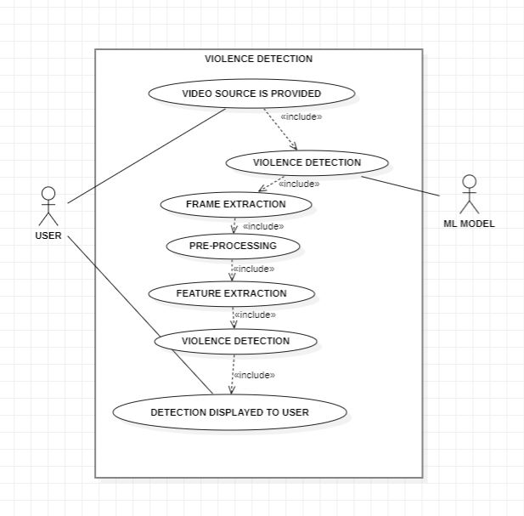
Use-Case Diagram:

Slide 15
Use-Case Diagram: continued..
Key Actors and Use Cases:
User: The human operator who provides the video source and interacts with the system.
Backend System: Handles video processing, frame extraction, and violence detection.
Core Use Cases:
Start/Stop System
Capture Video Frames
Pre-process Frames
Extract Features
Detect Violence
Display Detection Result

Slide 16
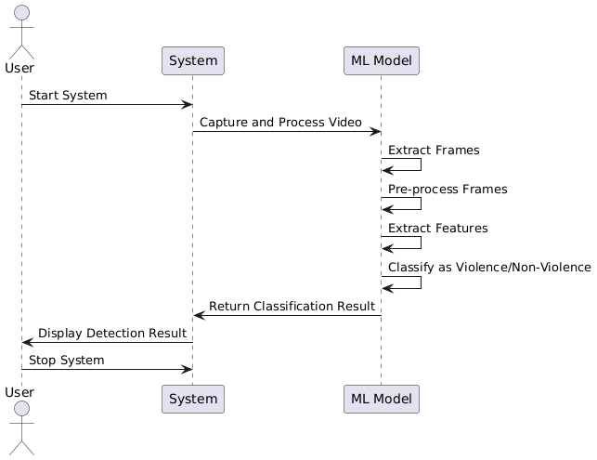
Sequence Diagram :

Slide 17
Sequence Diagram: continued..
User starts system
Video is provided
ML Model extracts frames
ML Model pre-processes frames
ML Model extracts features
ML Model classifies the event
System returns classification result
System displays detection results
User stops the system

Slide 18
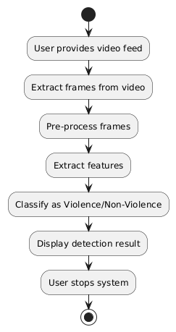
Activity Diagram:

Slide 19
Activity Diagram: continued..
Video Processing – The system receives a video feed and extracts frames for analysis.
Feature Extraction – Frames undergo pre-processing, and key features are extracted.
Violence Classification – The ML model classifies frames as violence or non-violence.
Result & Termination – The detection result is displayed, and the user can stop the system.

Slide 20
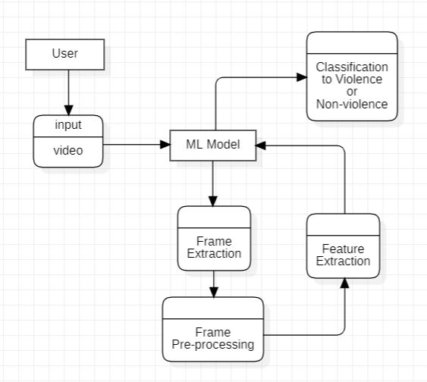
DataFlow Diagram :

Slide 21
Data Flow Diagram: continued..
User Inputs Video : The user provides a video feed to the system for analysis.
ML Model Processes Input : The video is sent to the ML model for further processing.
Frame Extraction & Pre-processing : The model extracts frames and applies necessary enhancements.
Feature Extraction & Classification : Extracted features help classify the video as Violence or Non-Violence.
Output is Delivered to User : The classification result is displayed to the user.

Slide 22
Results:
Real-Time Violence Detection:
The ANN, LSTM, and GRU-based model processes video frames to detect and classify violent activities with high accuracy.
High-Accuracy Violence Detection::
The system utilizes Artificial Neural Networks (ANN), Long Short-Term Memory (LSTM), and Gated Recurrent Units (GRU) to analyze video frames and detect violent activities with high accuracy. The trained model achieves:
ANN: 80.28% accuracy with a loss of 36.56
LSTM: 86.29% accuracy with a loss of 32.11
GRU: 92.01% accuracy with a loss of 34.3
Automated Alert System:
Upon detecting violent behavior, the system triggers an alert, notifying security personnel or authorities in real time to ensure swift intervention.

Slide 23
Results: continued..
Operational Efficiency:
The automated detection system minimizes the need for manual surveillance, enhancing efficiency and response time compared to traditional security monitoring methods.
User Control and Interface:
The web interface allows users to upload video files for analysis, start real-time monitoring, and stop the detection process at any time, providing flexibility and control.

Slide 24
Conclusion :
Deep Learning Powered Violence Detection System is a scalable, efficient, and robust solution designed to detect and monitor violent activity in real time. By leveraging deep learning-based feature extraction, sequential modeling, and artificial neural networks (ANNs), the system achieves high accuracy in identifying violence across diverse environments.
With real-time processing capabilities, the system efficiently handles video streams with minimal latency, making it ideal for applications in surveillance, law enforcement, and security. Its ability to analyze live footage quickly ensures timely detection and response to potential threats.
The system is designed to be scalable and reliable, allowing it to handle multiple video feeds without performance degradation. As an AI-based surveillance solution, it lays the groundwork for future advancements, including enhanced feature extraction techniques and deep learning model optimizations for even greater accuracy and efficiency.

Slide 25

Applications:

Slide 26
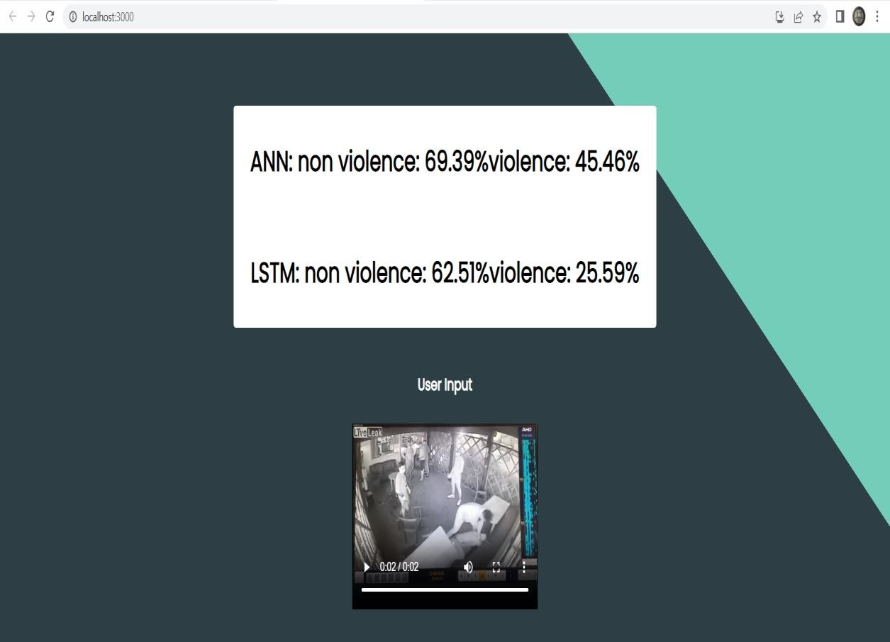

Slide 27
Related Research Works :
Bermejo, E., Deniz, O., Bueno, G., & Sukthankar, R. Violence Detection in Video Using Computer Vision Techniques.
Peixoto, B. M., Lavi, B., Dias, Z., & Rocha, A. Harnessing high-level concepts, visual, and auditory features for violence detection in videos.
Vijeikis, R., Raudonis, V., & Dervinis, G. (2017). Efficient Violence Detection in Surveillance. Informatica, 28(4), 753-770.
Garcia-Cobo, J. C., & SanMiguel, J. C. Human skeletons and change detection for efficient violence detection in surveillance videos.
Omarov, B., Narynov, S., Zhumanov, Z., Gumar, A., & Khassanova, M. State-of-the-art violence detection techniques in video surveillance security systems: a systematic review.

Slide 28
Thank You!

